Slide 1
X-ray Scattering: Liquid Metal/Vapor Interfaces P.S. Pershan SEAS & Dept of Physics, Harvard Univ., Cambridge, MA, US
I: Liquid Metal/Vapor Interfaces
II: Examples from experiments done by our group and others.
III: Open questions on surface freezing of liquid metals (Mechler)

Slide 2
Our Group.
Colleagues (~20 years)
Balagurusamy, V. S. K. Berman, E. √√Deutsch, M. DiMasi, E. Fukuto, M. Gebhardt , J. Gog, T. Graber, T. Grigoriev, A. | Huber, P. Kawamoto, E. H. Kuzmenko, I. Lin, B. H. Magnussen, O. M. √√Mechler, S. Meron, M. Ocko, B. M. Pontoni, D. | Regan, M. J. Sellner, S. Shpyrko, O. G. Steimer, C. Stoltz, S. Streitel, R. Tostmann, H. √√Yahel, E
Harvard, Non-Harvard, Beam Line
√√ Speakers at LAMXIV

Slide 3
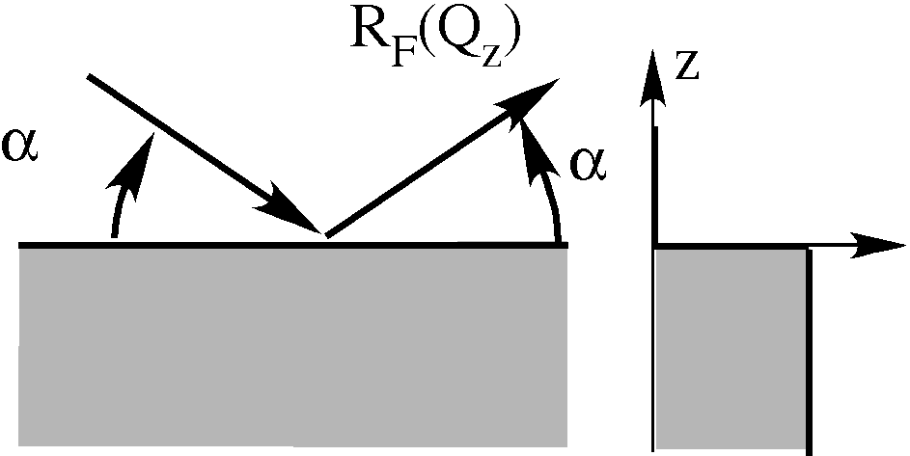
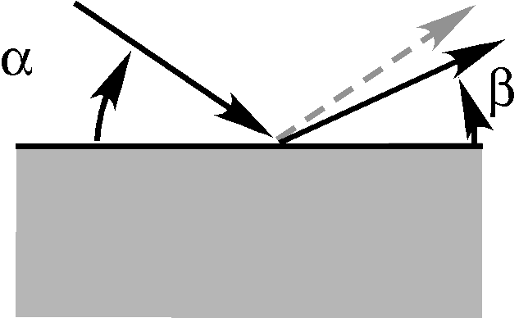
Fresnel X-ray Reflectivity
:
Diffuse scattering:

Slide 4
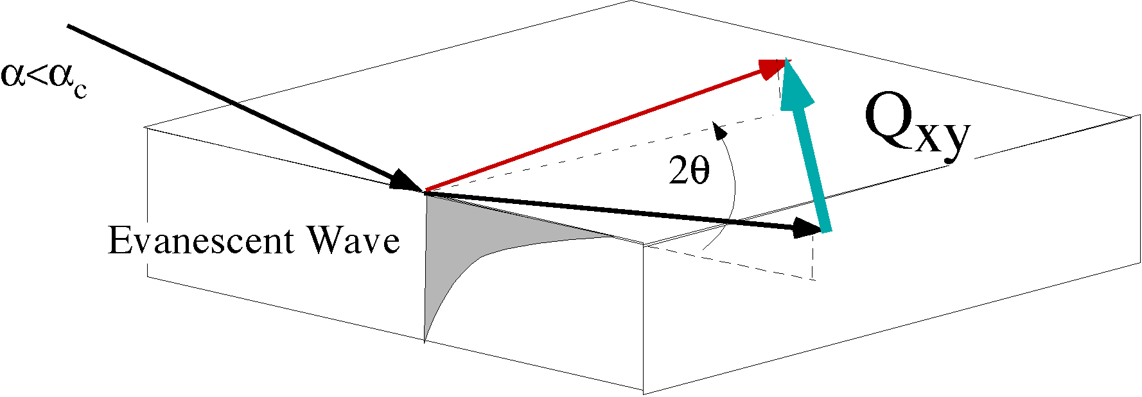
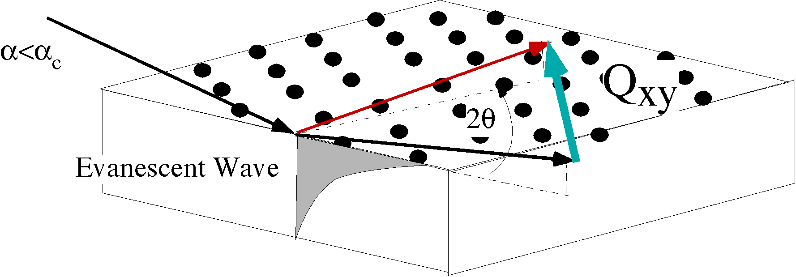
Grazing Incidence Diffraction (GID)
Diffuse Scattering at Larger
2D Bragg Peaks

Slide 5
Real Liquid Surfaces
Surface Structure
Thermal capillary waves
Reflectivity
Diffuse
Scattering

Slide 6
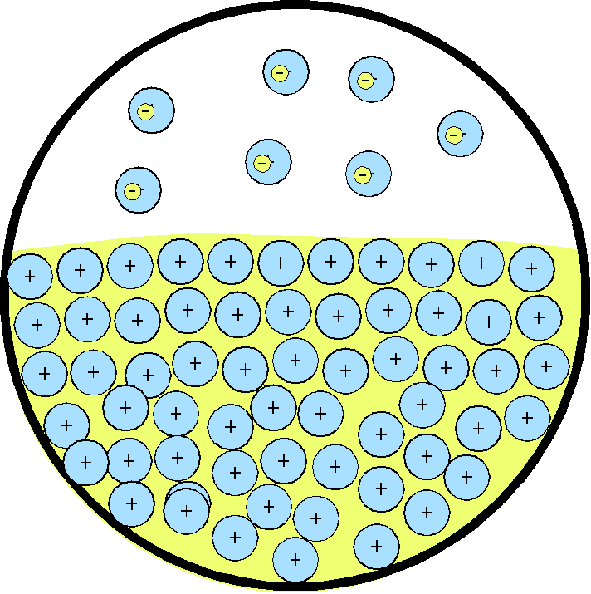
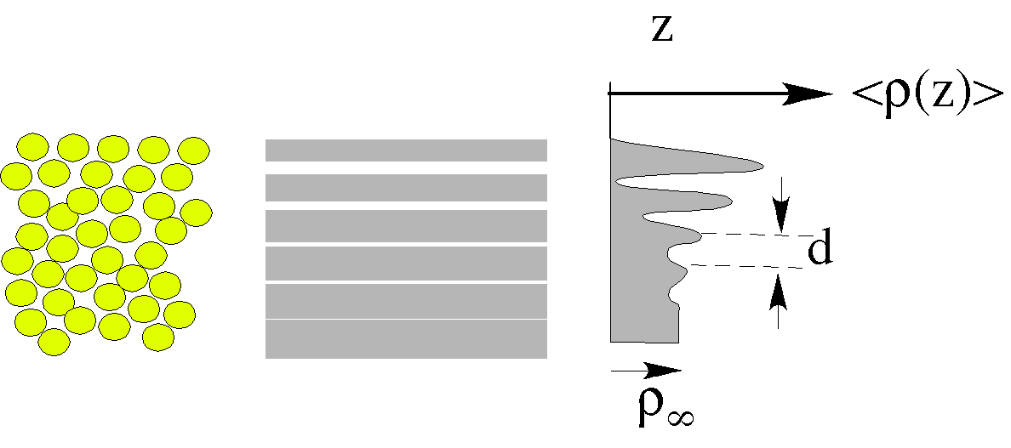
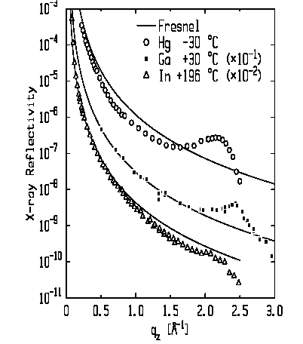
Type I: Elemental Liquid Layer Response of Bulk Susceptibility
Metallic Liquids (D’Evelyn & Rice ‘83)
Hg
Ga
Hg: Magnussen et al. (1995).
Ga: Regan et al.(1995)
In: Tostmann et al.(1999)
In

Slide 7
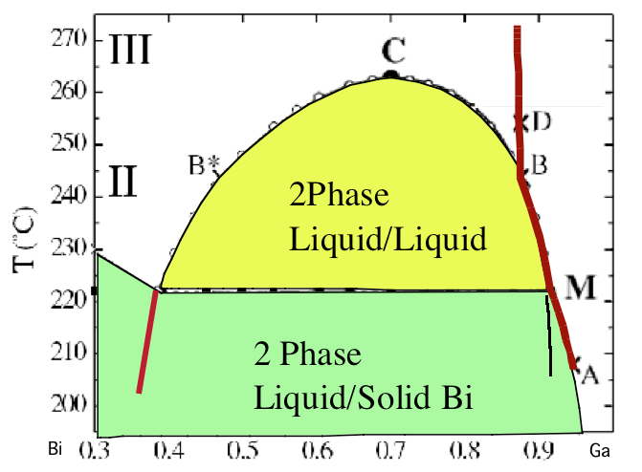
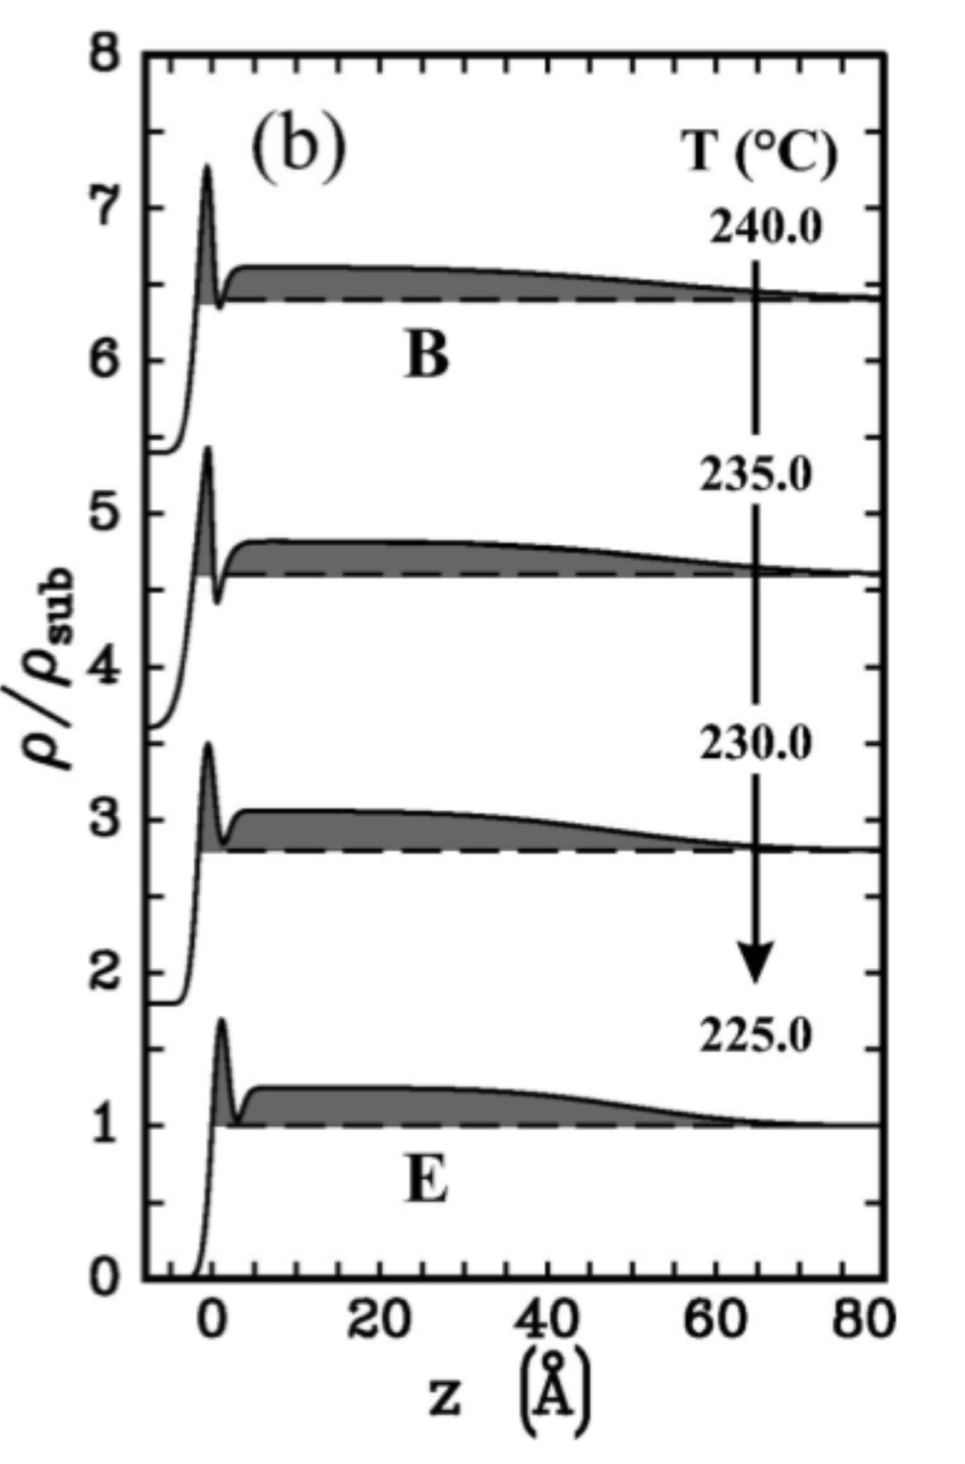
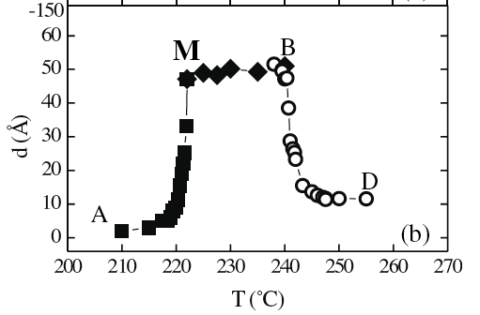
Type II: Surface Adsorption(Ga-Bi alloy) Bulk Phase Coexistence
Gibbs: < 1900
Butler: ’35
Egry: ‘05
Nattland &Freyland, ’94
Chatain & Wynblatt, ‘96
P. Huber,’03
Electron Density
d vs T
d
Calphad Initiative(data)➔Gibbs free energy density:
Influence Parameter:
ξ
Surface Tension

Slide 8
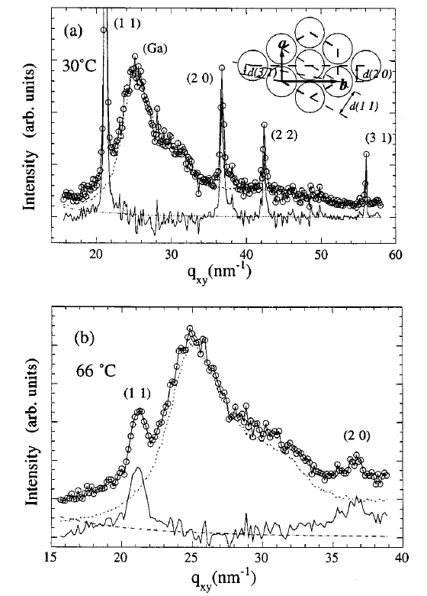
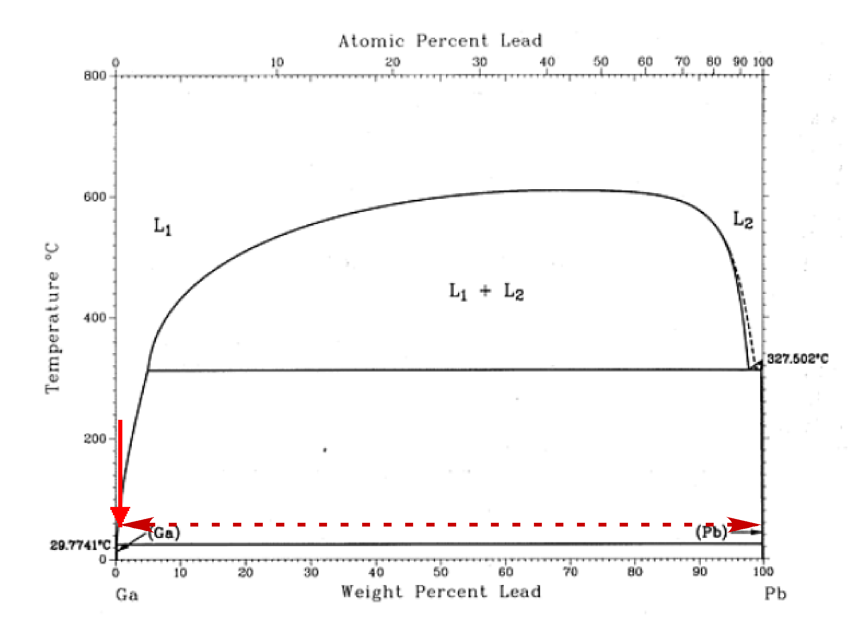
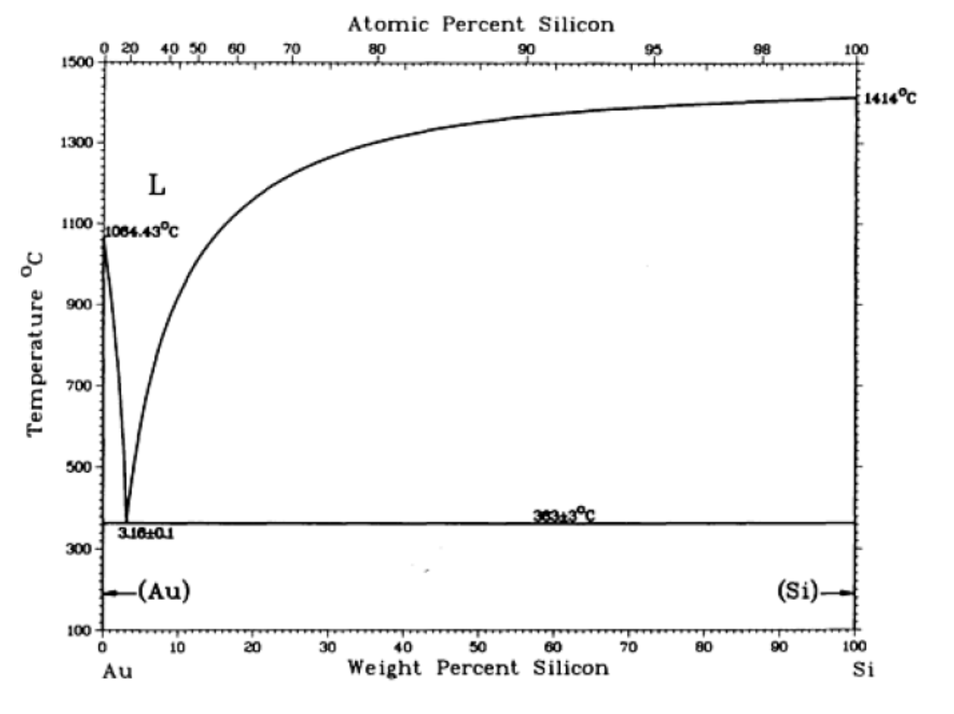
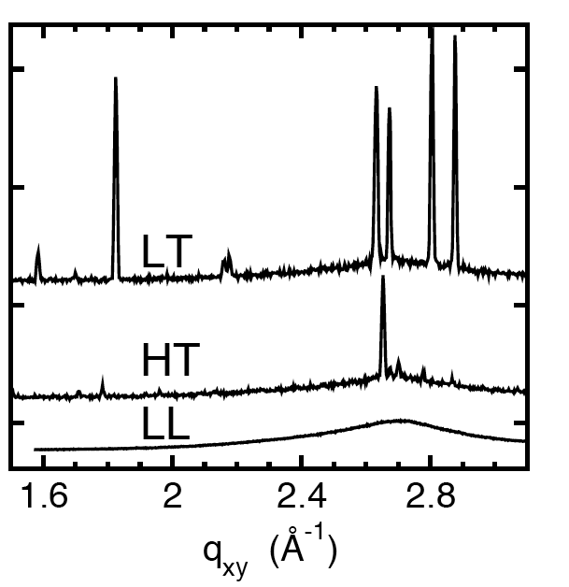
TypeIIIa: Surface Phase Transition 2 Phase Binary Solution
Yang et al. PRB. 62, 13111 (2000)
Gibbs Adsorption
Pb-monolayer on Ga
2D Crystal.
GID Scattering
Au-Si Eutectic
Shpyrko et al. Science 313, 77 (2006) vol. 313 (5783)
Mechler et al. LAMXIV (2010)
2D Au-Si Crystals
+Layer
Bilayer
Monolayer
Liquid
Is this Gibbs?

Slide 9
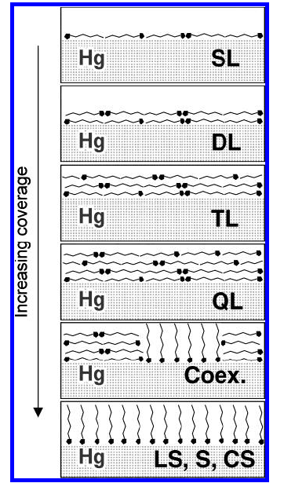
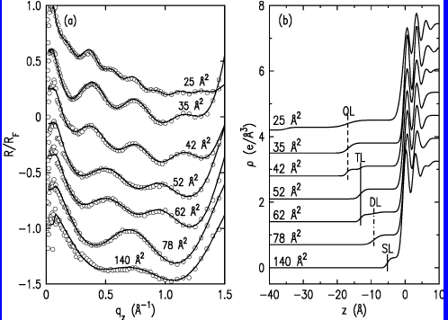
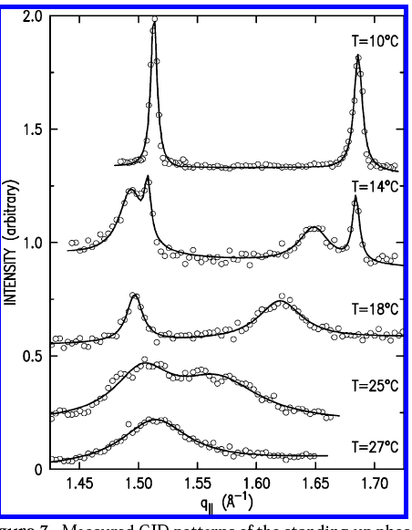
Type IIIb: Phase Transition (Insoluble Monolayer)
Kraack et al. The Structure and Phase Diagram of Langmuir Films of
Alcohols on Mercury. Langmuir 20, 5386 (2004)
GID

Slide 10
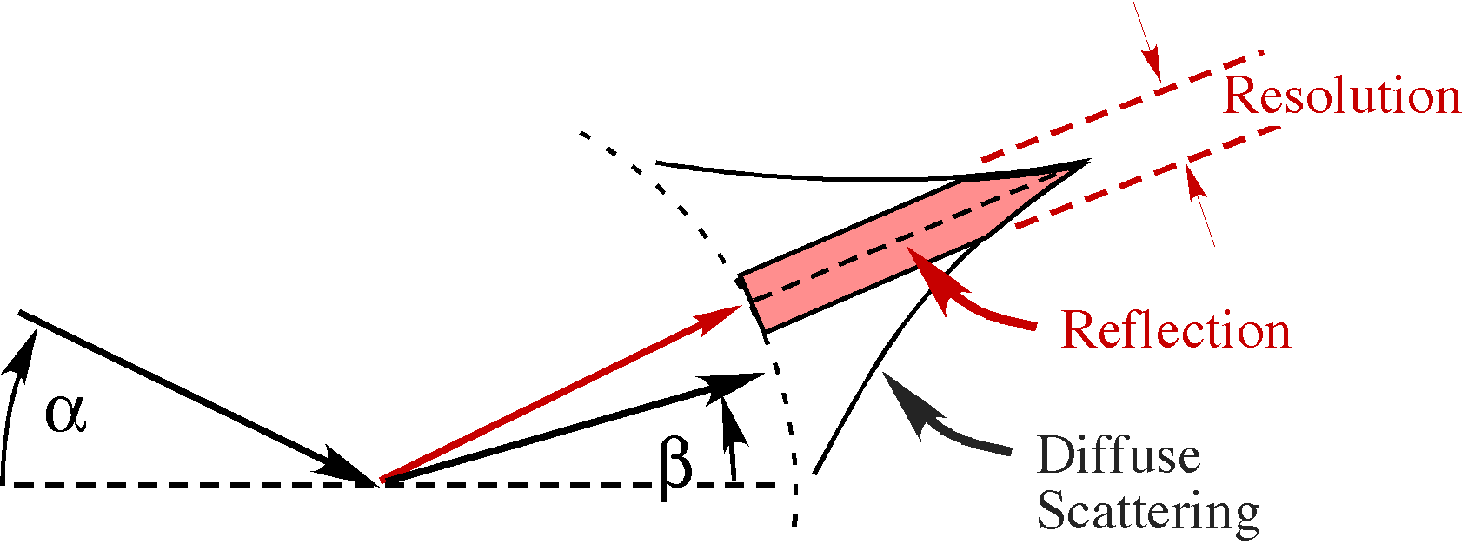
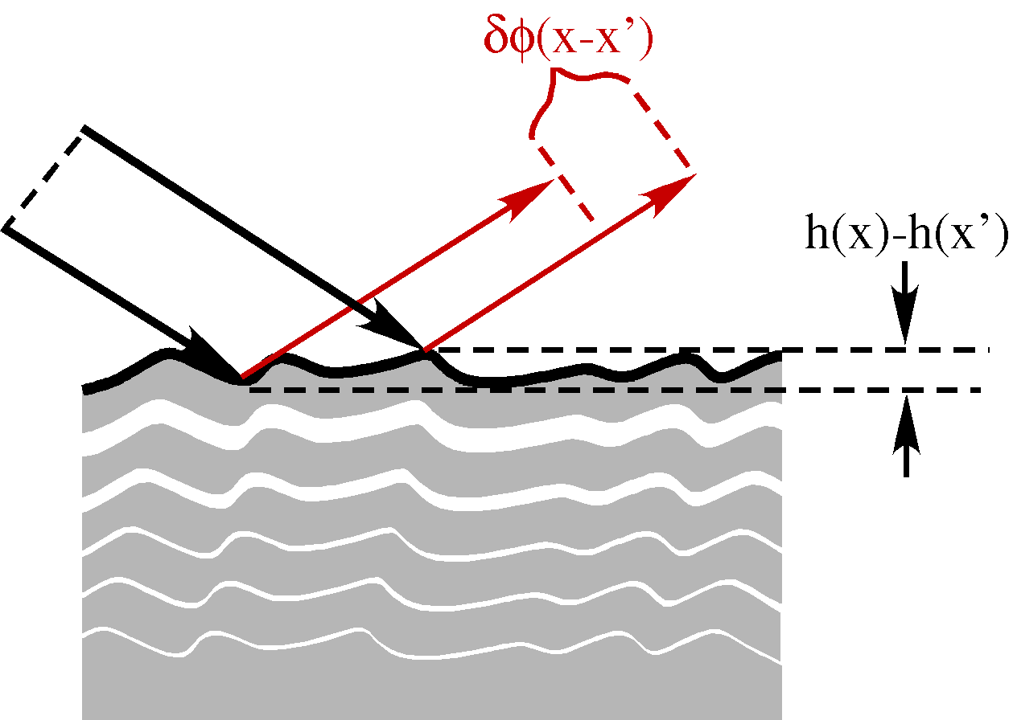
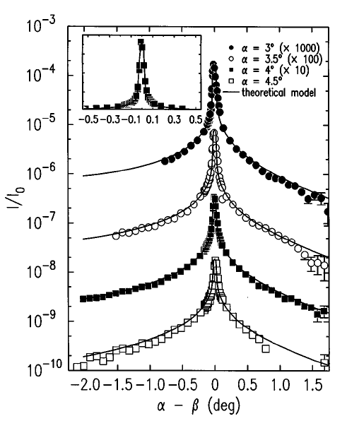
Structure Factor &Thermal Effects Debye-Waller⬅➔Capillary Waves
Diffuse Scat: In
2D
Debye-Waller
~0.01Å⁻¹

Slide 11
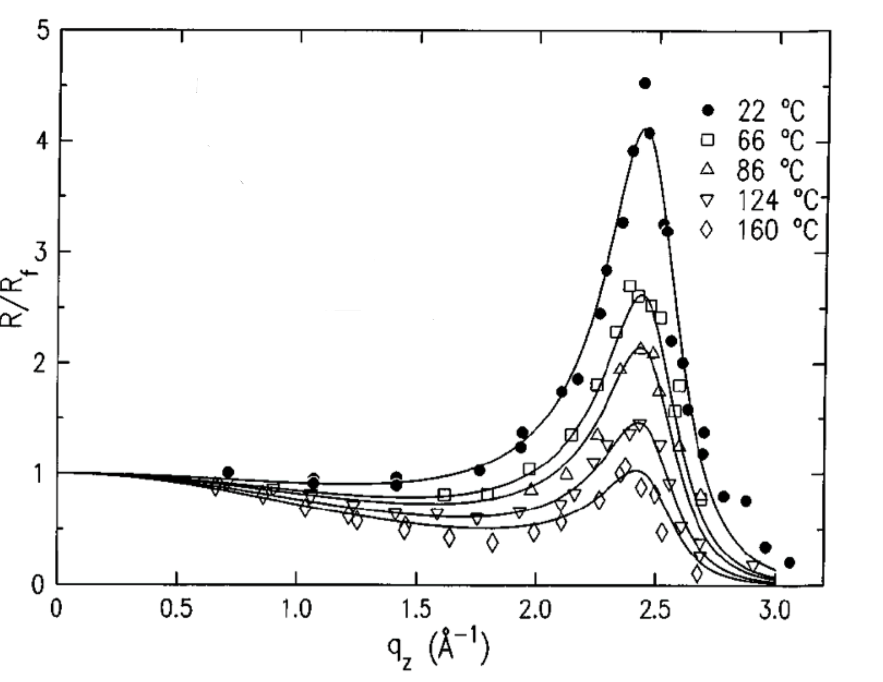
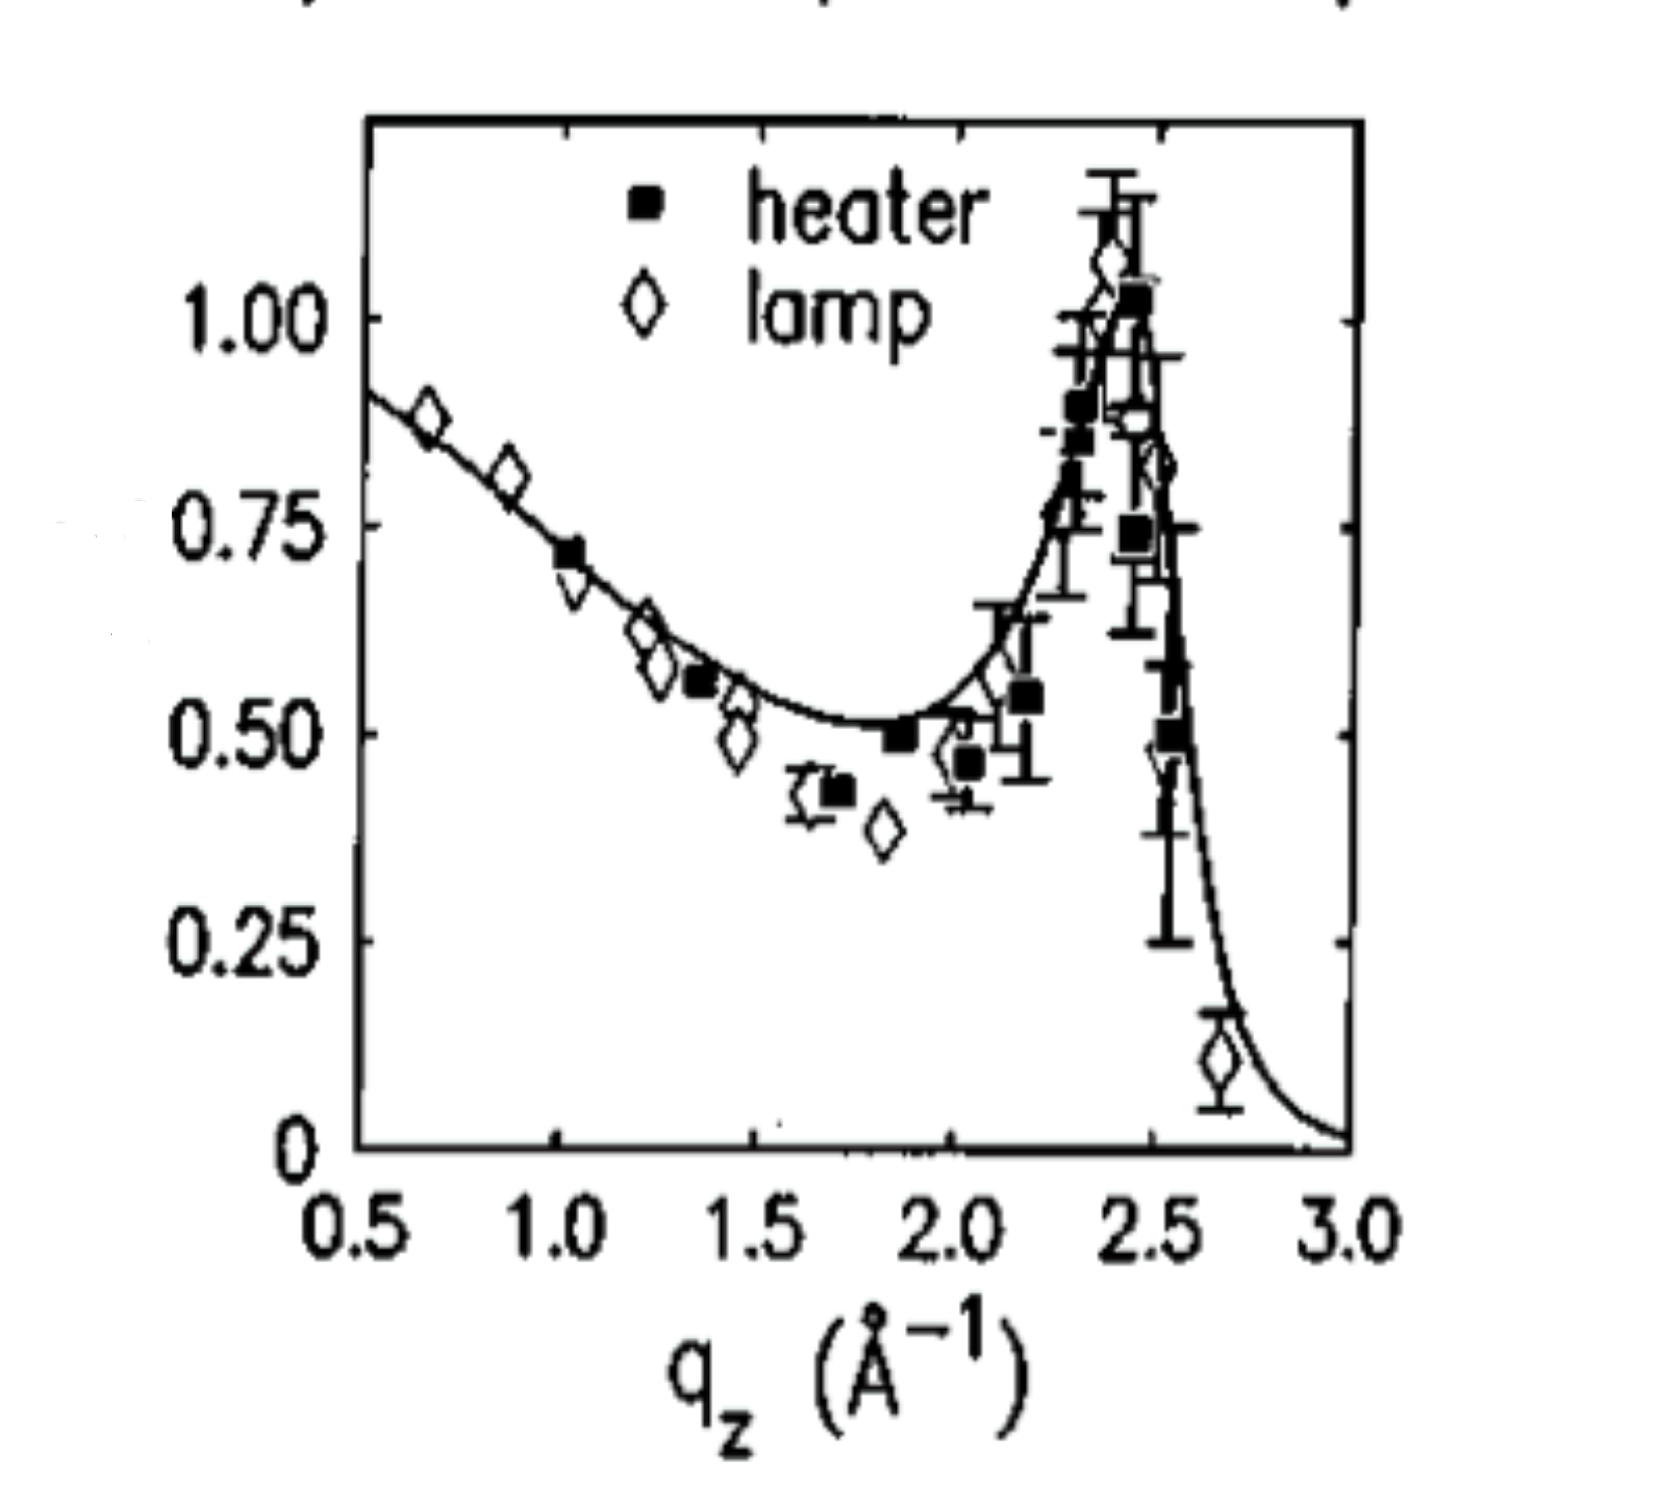
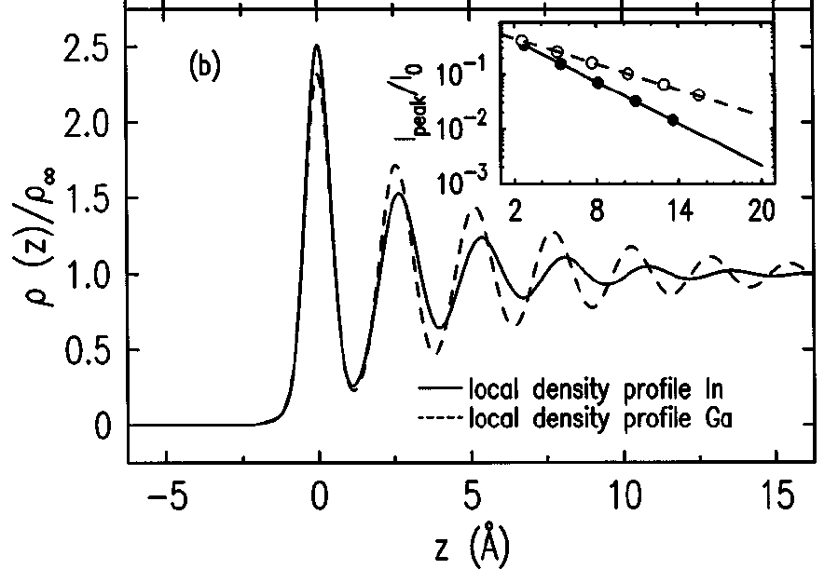
Debye-Waller Demonstration
Ga vs. T
Hg
Ga
Ga
In
In
Ga
In

Slide 12
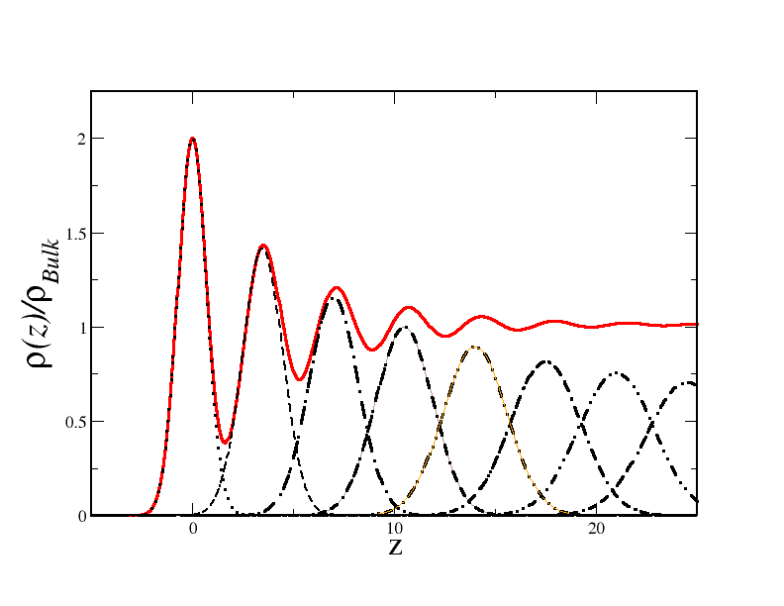
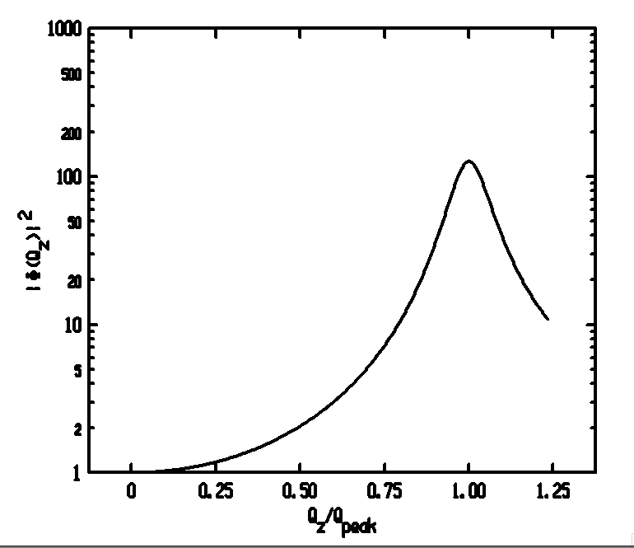
Distorted Crystal Layer Model
DCM (Magnussen ’95)
Only 3 Adjustable Parameters
n=0 1 2 3 ...

Slide 13
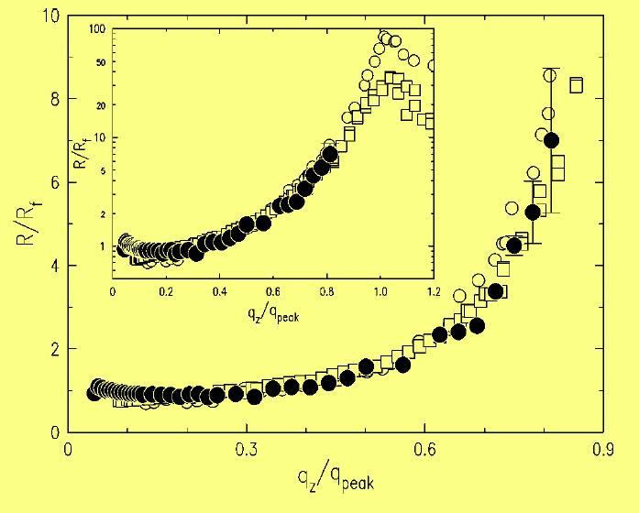
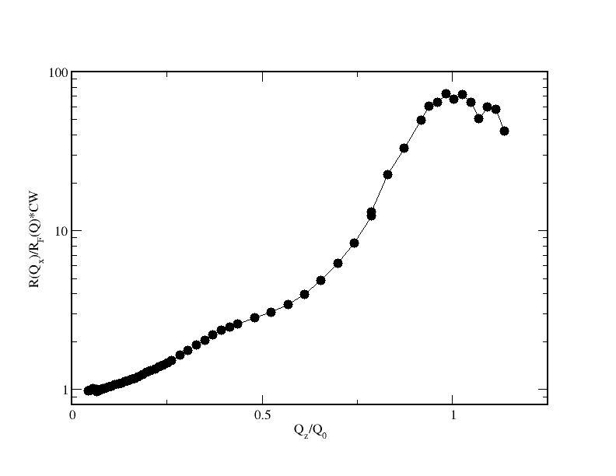
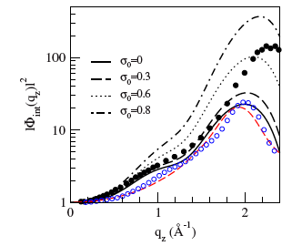
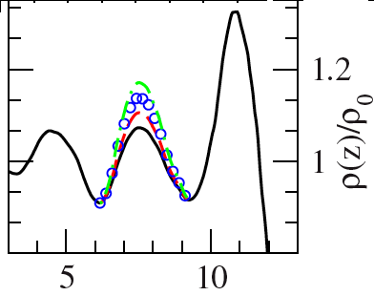
Elemental Liquid Metals Studied
K | Ga | In | Sn | Bi | Hg
DCM | DCM | DCM | +1 | +1 | ?
• | ○ | ☐ | • | ☐
Sn
No Bump⬅➔Bump
Why are 1st Layers for Bi and Sn different from K, Ga and In?
Mol. Dynamic. Simulations
Calderín et al.
PRB,80,115403 (2009)
Bi is like Sn! Why is Hg so different?

Slide 14
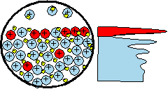
Eutectic Alloys
J. W. Gibbs <1900 Surface Adsorption: A/B Alloy If Surface Tension: γ_{A} > γ_{B} Surface is Rich in “B”.
A_{x}B_{1-x} | γ(A)/γ(B) | ΔH* (mixing) | Concentration of Surface Layers
 |  |  | 1st | 2nd | 34d
Ga_{x}Bi_{1-x} | 718/378=1.90 | +4 | Liquid-Liquid Phase Sep.
Ga_{83.5}In_{16.5} | 718/556=1.29 | +5 | 97%In
In₇₈Bi₂₂ | 556/378=1.47 | -1 | 35%Bi
Sn₅₇Bi₄₃ | 560/378=1.48 | +1 | 96%Bi | 25%Bi | 53%Bi
Au₇₁Sn₂₉ | 1100/560=1.96 | -10 | 96%Sn | <1%Sn | 24%Sn
Au₇₂Ge₂₈ | 1100/621=1.77 | -21 | No Gibbs Adsorption
Au₈₂Si₁₈ | 1100/865=1.27 | -30 | 4-layers, 2DXtal (AuSi₂)
Pd₈₁Ge₁₉ | 1500/621=2.4 | -44 | ~40 Å wetting layer (No Measureable Gibbs Adsorption)

Slide 15
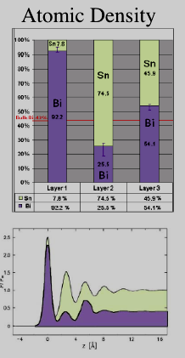
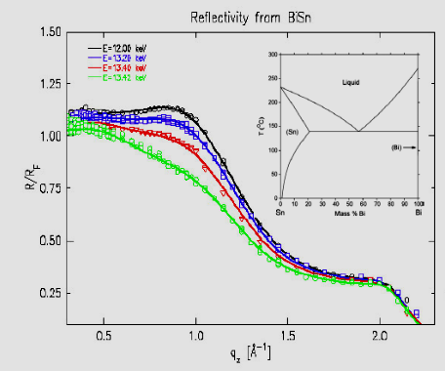
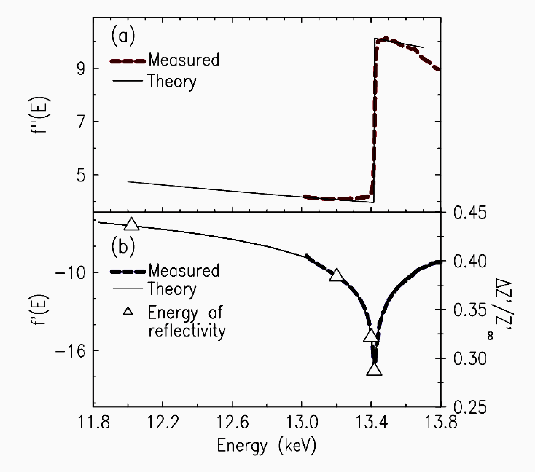
Gibbs Surface Adsorption(BiSn)
Alloy: Bi and Sn
γ_{Bi}=378, γ_{Sn}=560,
Energy Dispersion:
Bi:L3 f(E)
Adsorption
Scat. Ampl.
γ(Bi)≈ 398 γ(Sn)≈ 567 dyne/cm

Slide 16
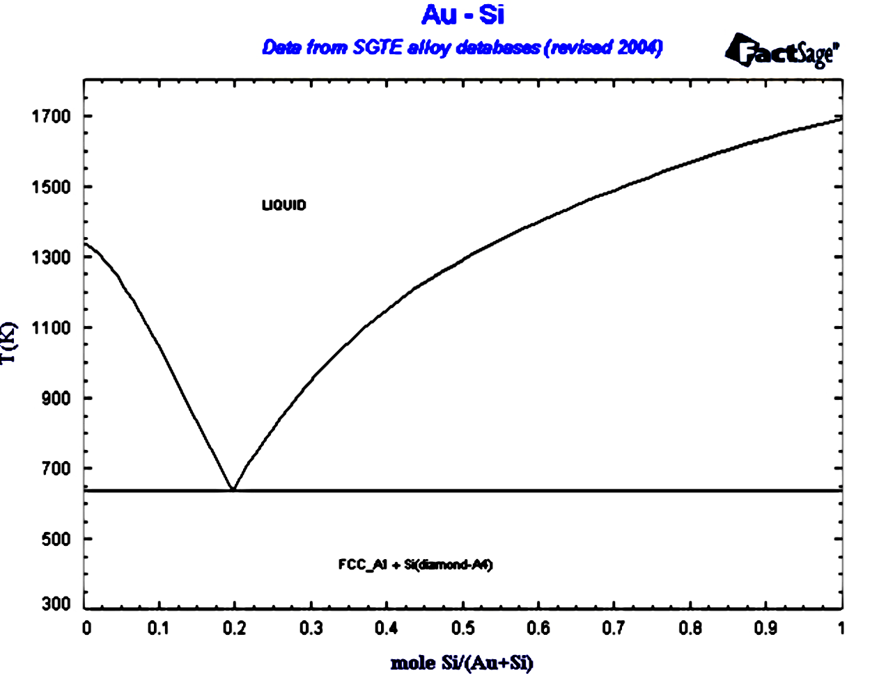
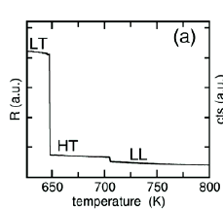
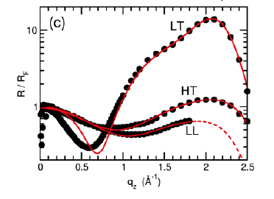
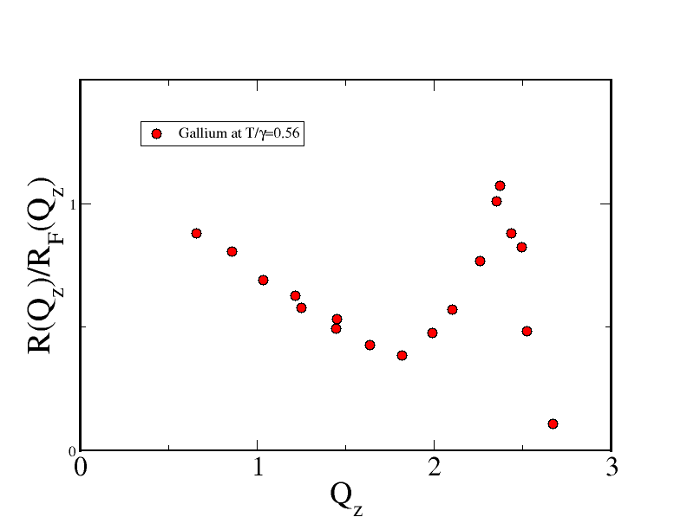
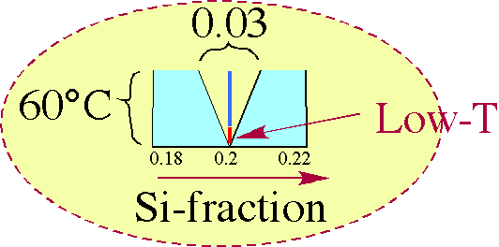
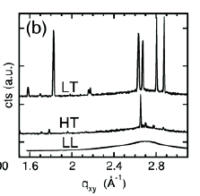
Surface Freezing Au₈₂Si₁₈Eutectic
T/γ~0.8
Gallium
T/γ~0.56
Si
Au
Mechler (LAMXIV)
2D-Crystal ➔Rigidity
Bragg Peaks
LT: Bilayer Xtal
HT: Monolayer
LL: Liquid
Rigidity Reduces Debye-Waller

Slide 17
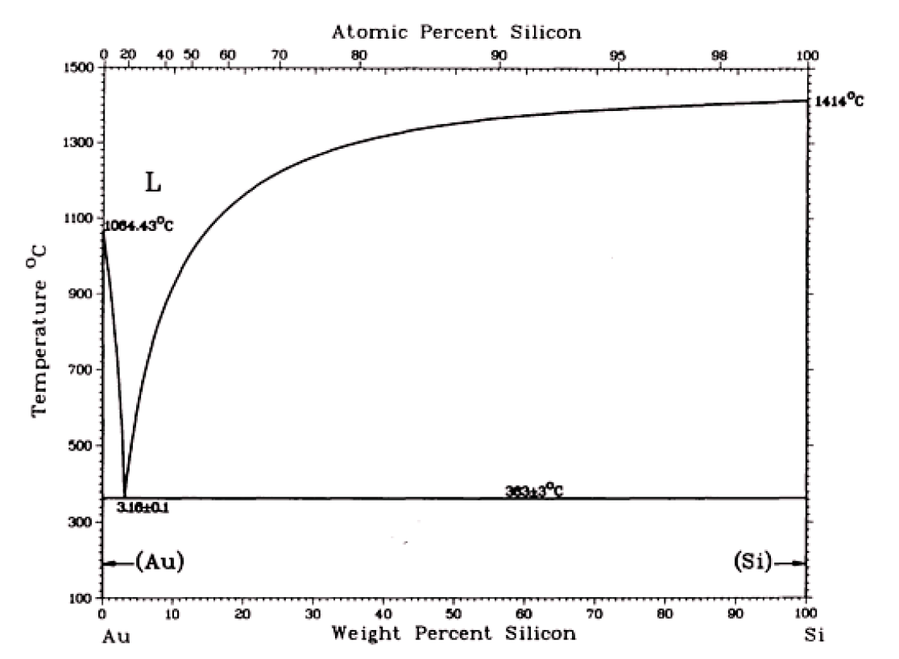
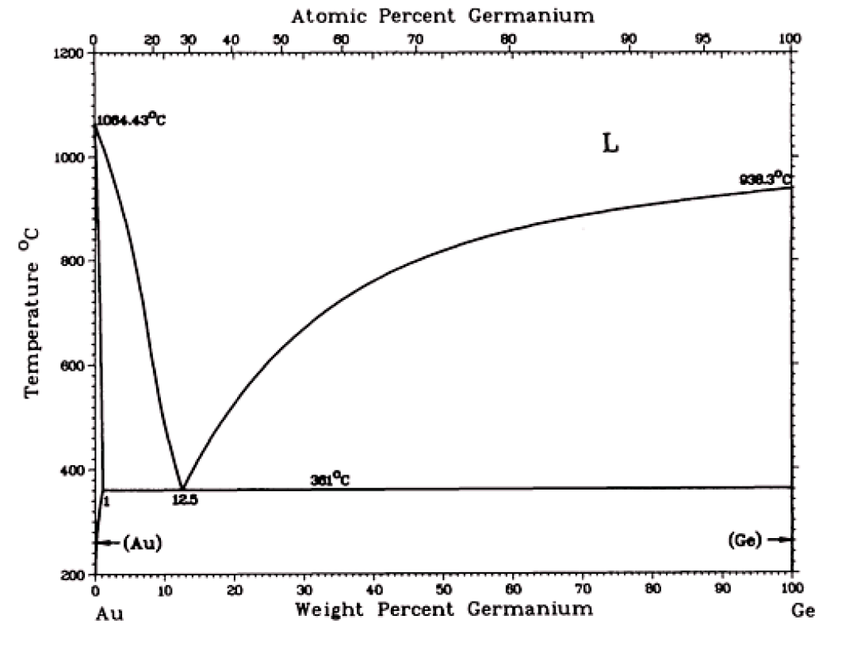
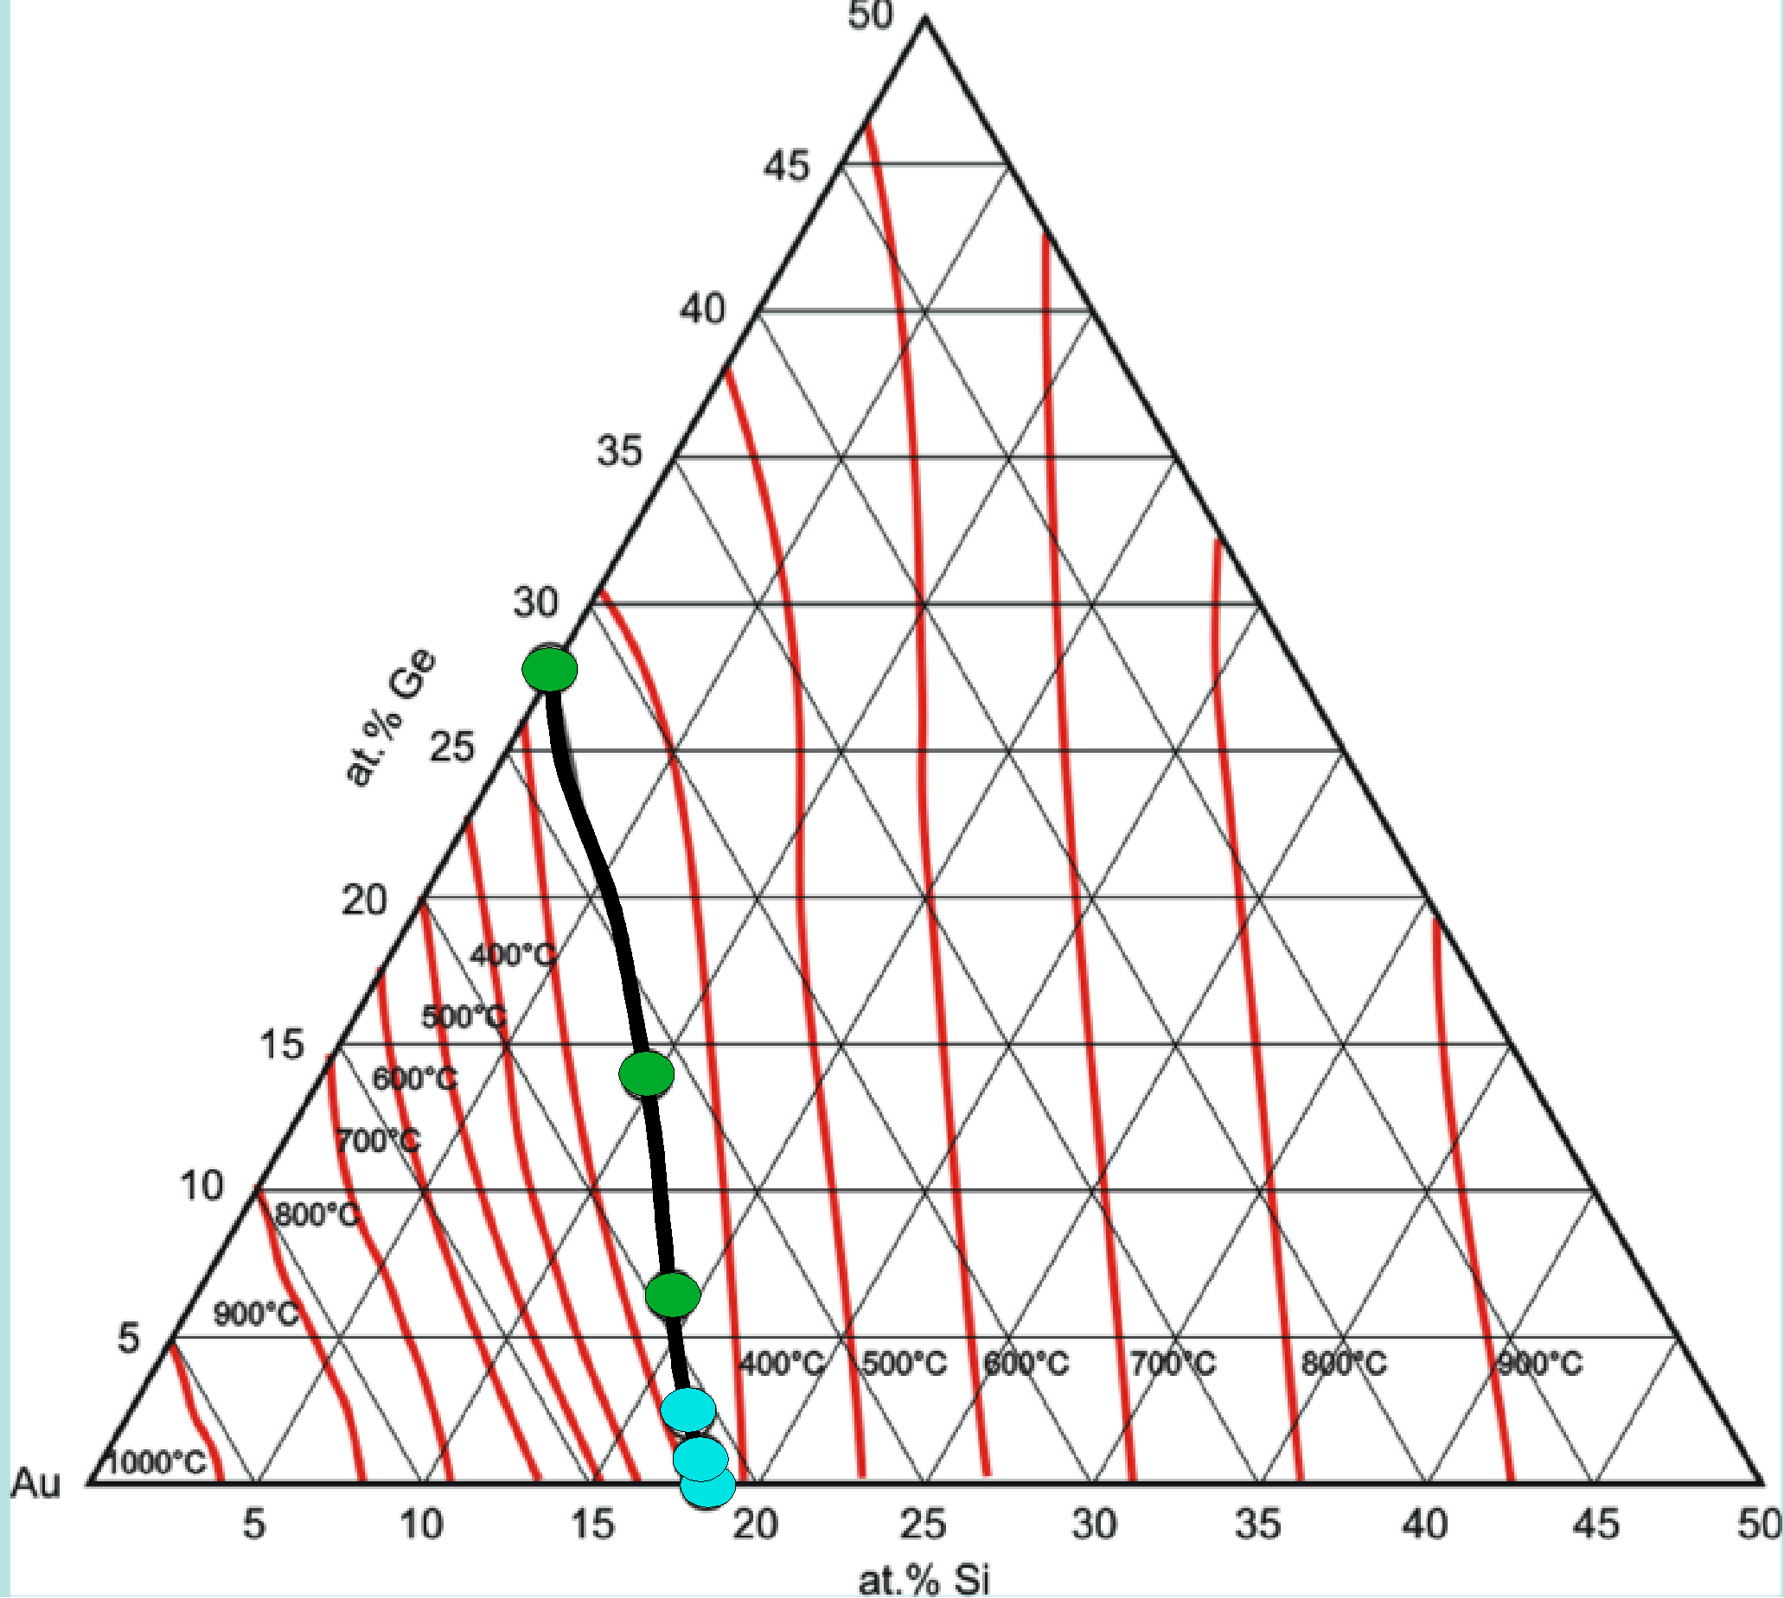
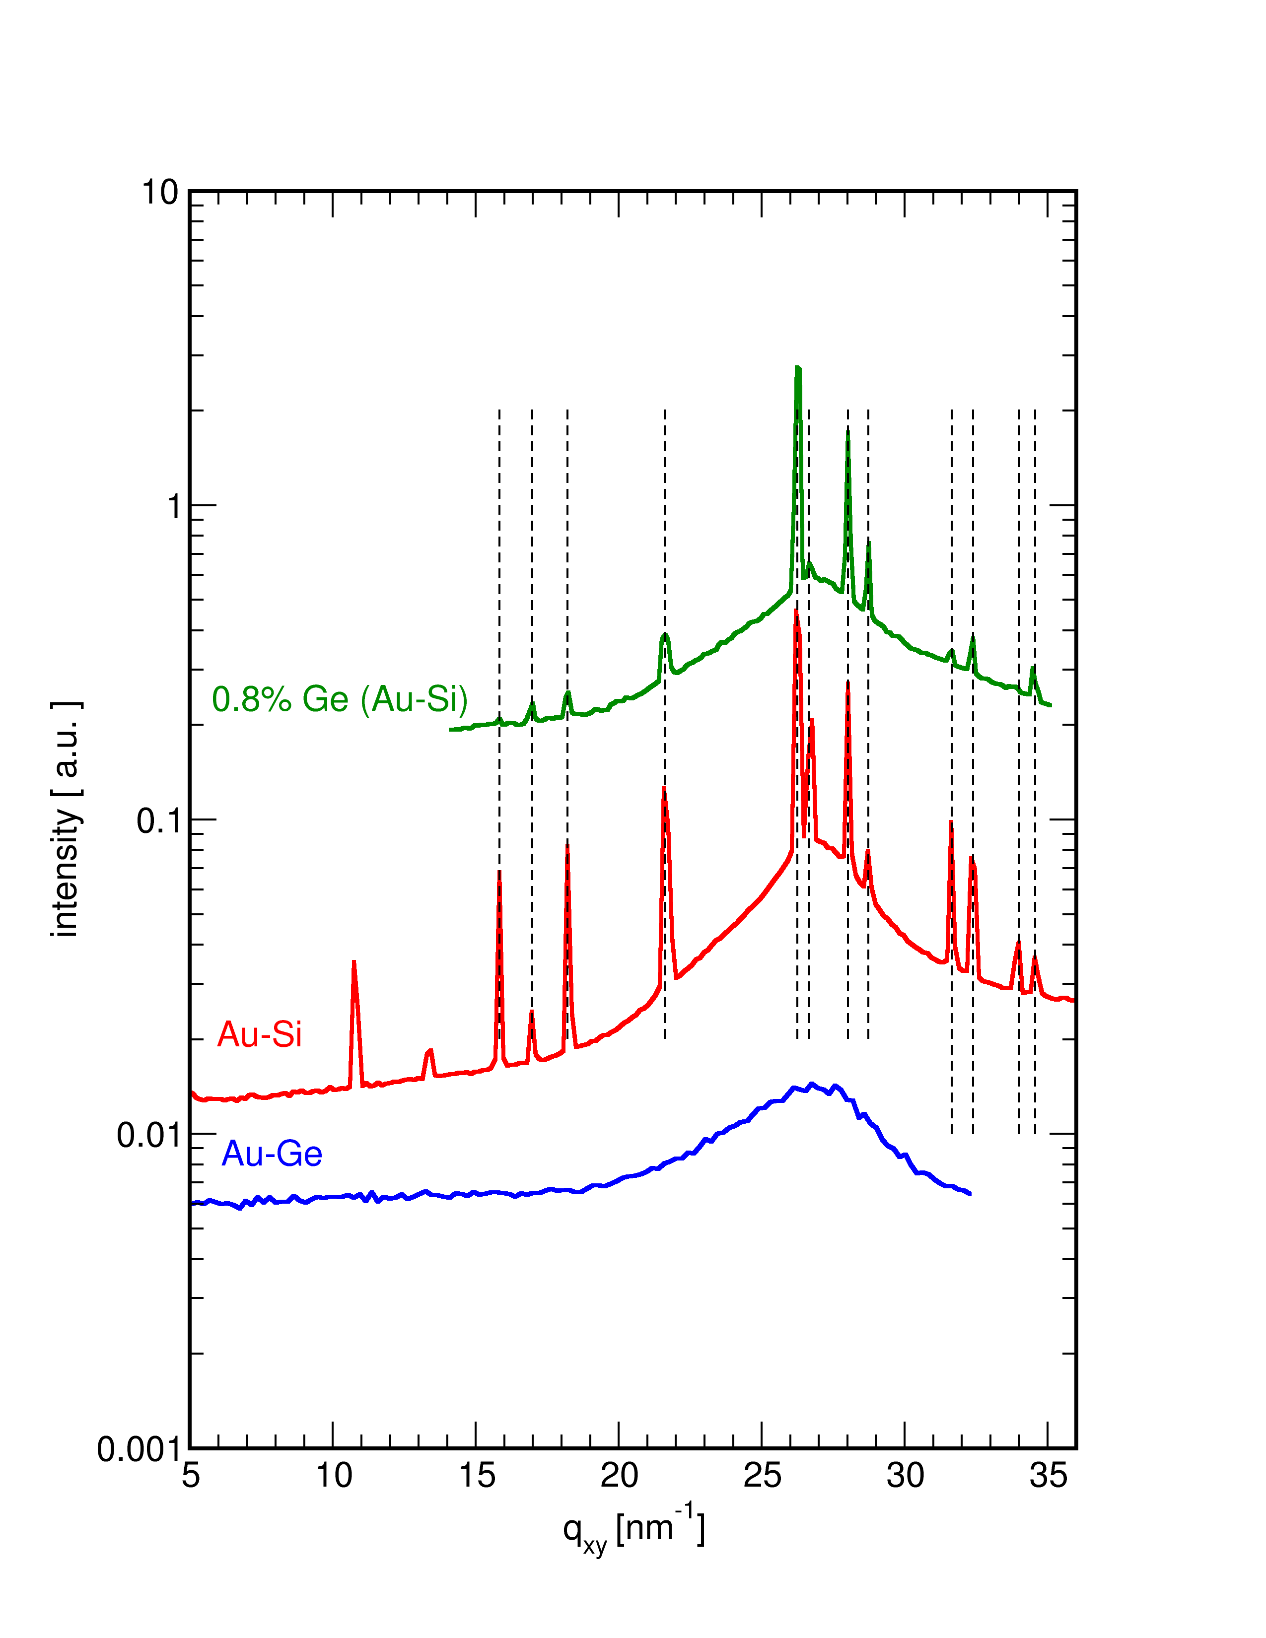
AuGe Eutectic(Should be Similar to Au-Si)
 | γ(Au)/γ(Si or Ge) | ΔH
Au₇₂Ge₂₈ | 1100/621=1.77 | -21
Au₈₂Si₁₈ | 1100/865=1.27 | -30
Au-Si
Au-Si
Au-Ge
2D GID Scans
Au-Ge is Different from Au-Si
No Surface Freezing • Why?
Pasturel et al. Structure- Liquid Au-Si - molecular dynamics. PRB (2010)
Surface Frozen Ge≤6.5 atm%
Upmanyu et al. (in preparation): NE
Sub surface Si enrichment!
Si (Surface) (Au-Si) (bonding)

Slide 18
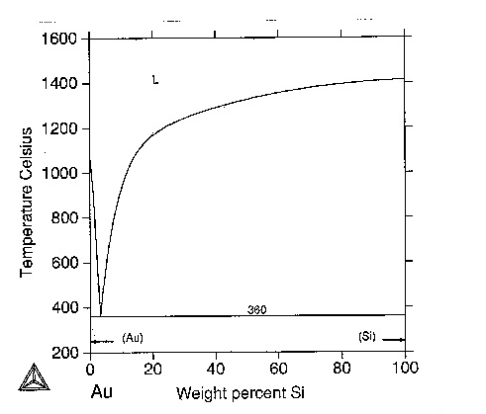
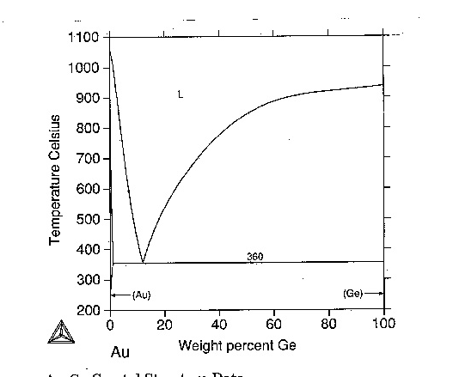
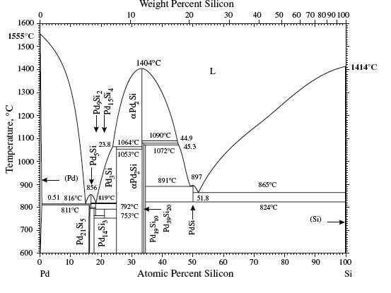
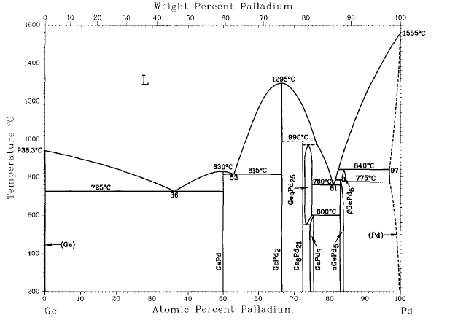
Surface Freezing of Au₈₂Si₁₈ and Glass Forming!(Mechler)
Au-Si
Au-Ge
Glass Former
Not A Glass Former
Pd-Si
Pd-Ge
Glass Former
Glass Former

Slide 19
Summary
Elemental metals ➔Surface induced layering.
Simplest Distorted Crystal Model (Ga,In, K)
Debye-Waller Effects of Thermal Capillary Waves
Near surface deviations from DCM (Sn, Bi).
Other Metal/Vapor Interfaces
2 Phase Binary Alloys (Ga-Bi, Ga-Pb, Ga-Tl)➔ Gibbs Adsorption, Wetting, 2D Crystals
Langmuir Monolayers on Hg (Deutsch)
Unexplained behavior of Au₈₂Si₁₈ (Mechler)
Eutectic 2D Surface phase transitions for Au-Si
New Results I: Au-Cu-Si: (Mechler: LAMXIV)
New Results II: Liquid Ge: No Layering
(Private Discussion: Mechler and Yahel)
New Results from Others:Liquid Metal/Solid: (Deutsch: LAMXIV)

